Slide 1
Module 1: Lesson 4:
Understanding
Azure Container Services, Function and Virtual Desktop

Slide 2


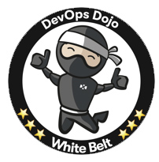




About The Presenter
Muhammad Gouda
Senior Consultant at Microsoft Egypt. Over 18 years of experience
Certified Azure Developer
Hold DevOps Dojo White Belt
Certified Scrum Master
Certified Problem Solver from HackerRank
in/muhammadgouda/
Certified ITIL Foundation
Notes:
How Cloud Can Help DevOps Transformation

Slide 3


Lesson 4: Overview
This lesson will cover
Decide when to use Azure Container Instances or Azure Kubernetes Service
Decide when to use Azure Functions or Logic Apps
Decide when to use Azure Virtual Desktop
Notes:
How Cloud Can Help DevOps Transformation

Slide 4
Module 1: Lesson 4:
Azure Container Instances (ACI)
Notes:
https://docs.microsoft.com/en-us/learn/modules/azure-compute-fundamentals/azure-container-services

Slide 5

What is a Container

Slide 6
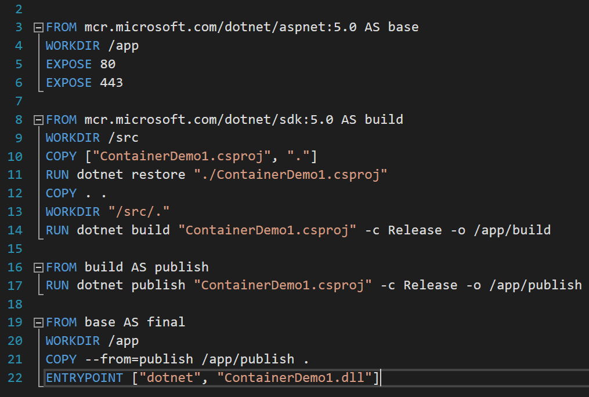
What is a Container
Dockerfile

Slide 7
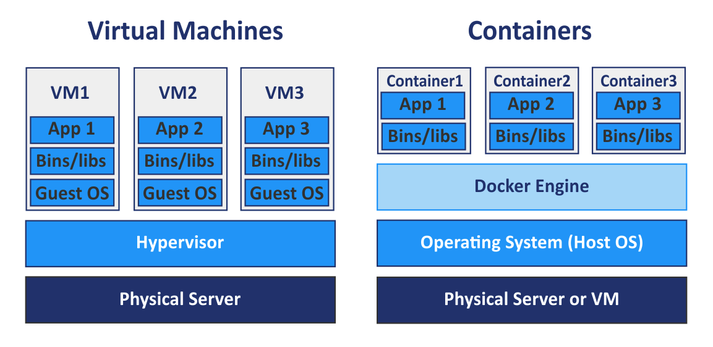
Container vs VM
Virtual OS
Virtual HW

Slide 8
Container vs Traditional App
Traditional App
App 1
App 2
App 3
Dependencies of App 1, 2, & 3
Operating System
Physical Server or VM

Slide 9
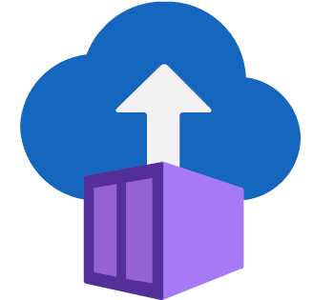
Azure Container Instances (ACI)
PaaS Service
Fits for simple apps, batch jobs, automation script
No auto scaling

Slide 10
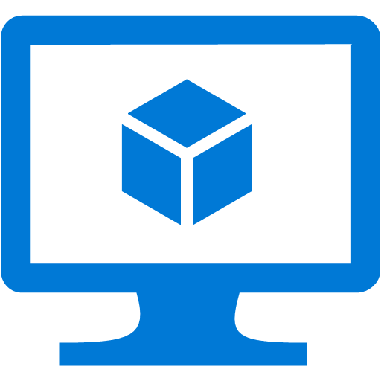
When to use what
Lighter weight and Smaller Size
Faster to build and launch
More control

Slide 11

When to use what
Dedicated for Web Stuff
Web Apps
Web APIs
Auto scaled
Generic, fits for batch jobs and scripts
No auto scaling

Slide 12
Module 1: Lesson 4: Demo1:
Azure Container Instance
Notes:
AKS Demo: Run below command in cloud shell to get app IP
kubectl get service azure-vote-front --watch

Slide 13
Module 1: Lesson 4:
Azure Kubernetes Service (AKS)
Notes:
https://docs.microsoft.com/en-us/learn/modules/azure-compute-fundamentals/azure-container-services

Slide 14
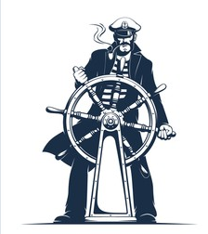
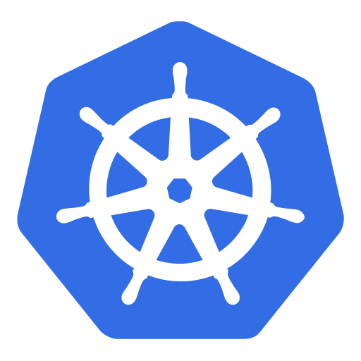
What is Kubernetes (K8s)?
Containers
Kubernetes

Slide 15
Why Kubernetes?
K8s Cluster
Node Pools
Pod
Container
Node (VM)
Orchestration of large number of containers
Deployment Automation
Scaling in/out
Manage failure
Manage deployment
Manage Network and Storage

Slide 16
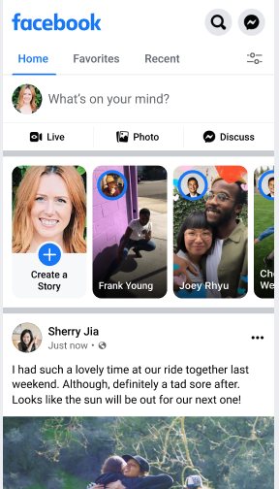
When to use Kubernetes?
With Microservices Architecture
Messages
New Post
Photos
Stories
Wall
Notes:
Quick Start Tutorial: https://docs.microsoft.com/en-us/azure/aks/kubernetes-walkthrough-portal

Slide 17
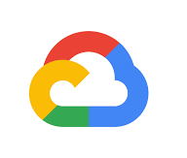
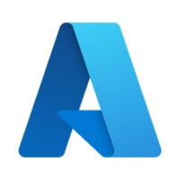

Hint
Containerized = Cloud Native
Notes:
https://docs.microsoft.com/en-us/learn/modules/azure-compute-fundamentals/azure-functions

Slide 18
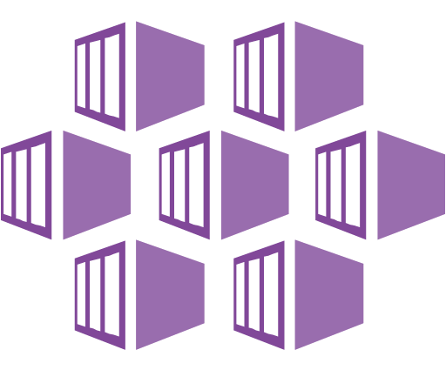
Module 1: Lesson 4: Demo2:
Azure Kubernetes Service
Notes:
AKS Demo: Run below command in cloud shell to get app IP
kubectl get service azure-vote-front --watch

Slide 19
Module 1: Lesson 4:
Azure Functions and Logic Apps
Notes:
https://docs.microsoft.com/en-us/learn/modules/azure-compute-fundamentals/azure-functions

Slide 20

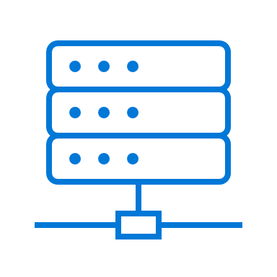
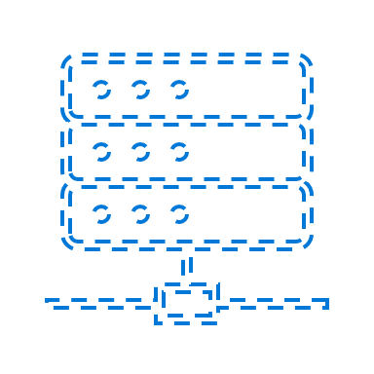
Serverless Services
IaaS
PaaS
Serverless (FaaS)
There is a server
There is a server
There is a server
Always consumed
Always consumed
Consumed on demand
Doesn’t change
Doesn’t change
Changes
Direct Access
No Access
No Access

Slide 21

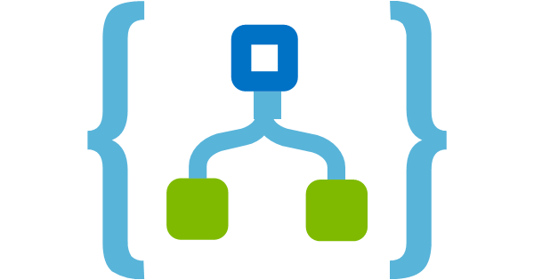
Azure Functions and Logic Apps | Common
Strongly Support Serverless
Can work as PaaS if needed
Event Driven
Timer
HTTP (e.g., API is called)
Another resource (e.g., Service Bus Queue Message)
Auto scales
Pay per consumption (Micro-billing)

Slide 22
Azure Functions and Logic Apps | Differences
Imperative (code)
Stateless vs Durable Functions
.NET, Node.js, Python, Java, PowerShell
Built-in + Custom binding types
Custom logic
Declarative (graphical workflow)
Stateful
Persisted in JSON format
Built-in + Custom Connectors
Ready-made actions

Slide 23
When to Use
Event driven scenarios
Auto scaling is critical
The task will take short time (seconds)
Simple tasks (single function)
Complex orchestration (collection of functions or steps)

Slide 24


Example
Whenever new customers register or update their profile info in the mobile app, the system must notify CRM system with the update instantly.
Processing
Processing

Slide 25
Module 1: Lesson 4: Demo3:
Functions & Logic Apps
Notes:
AKS Demo: Run below command in cloud shell to get app IP
kubectl get service azure-vote-front --watch

Slide 26
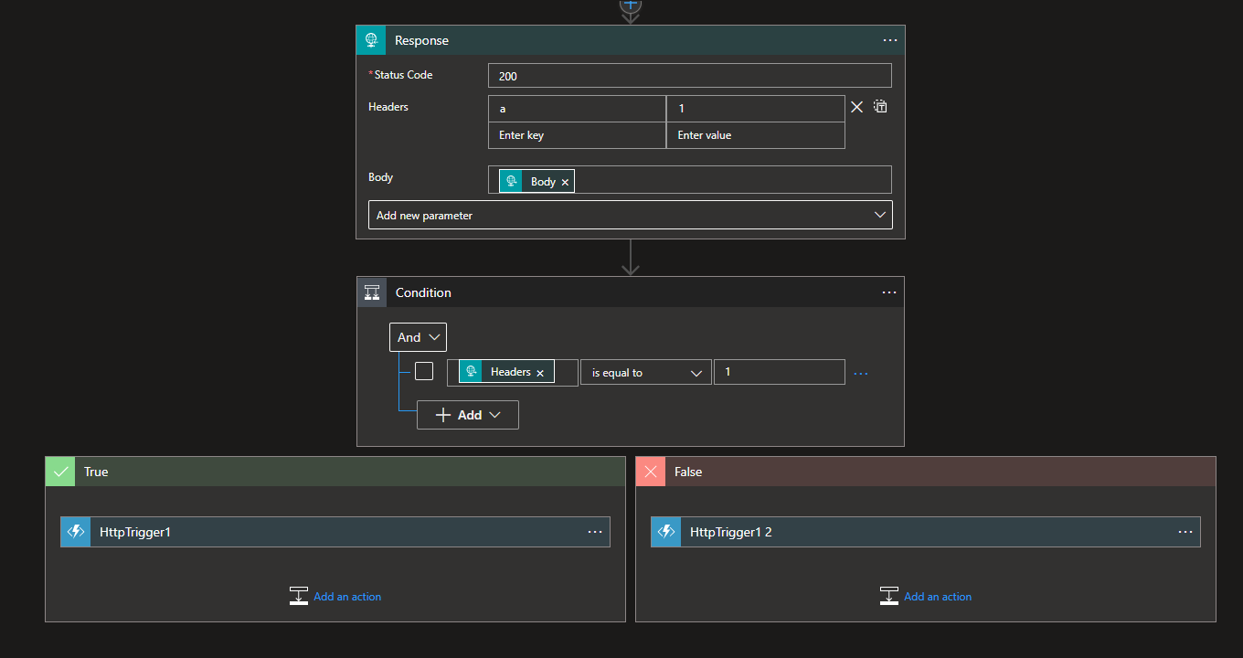
Sample Logic App
Notes:
https://docs.microsoft.com/en-us/learn/modules/azure-compute-fundamentals/windows-virtual-desktop

Slide 27
Module 1: Lesson 4:
Azure Virtual Desktop
Notes:
https://docs.microsoft.com/en-us/learn/modules/azure-compute-fundamentals/windows-virtual-desktop

Slide 28



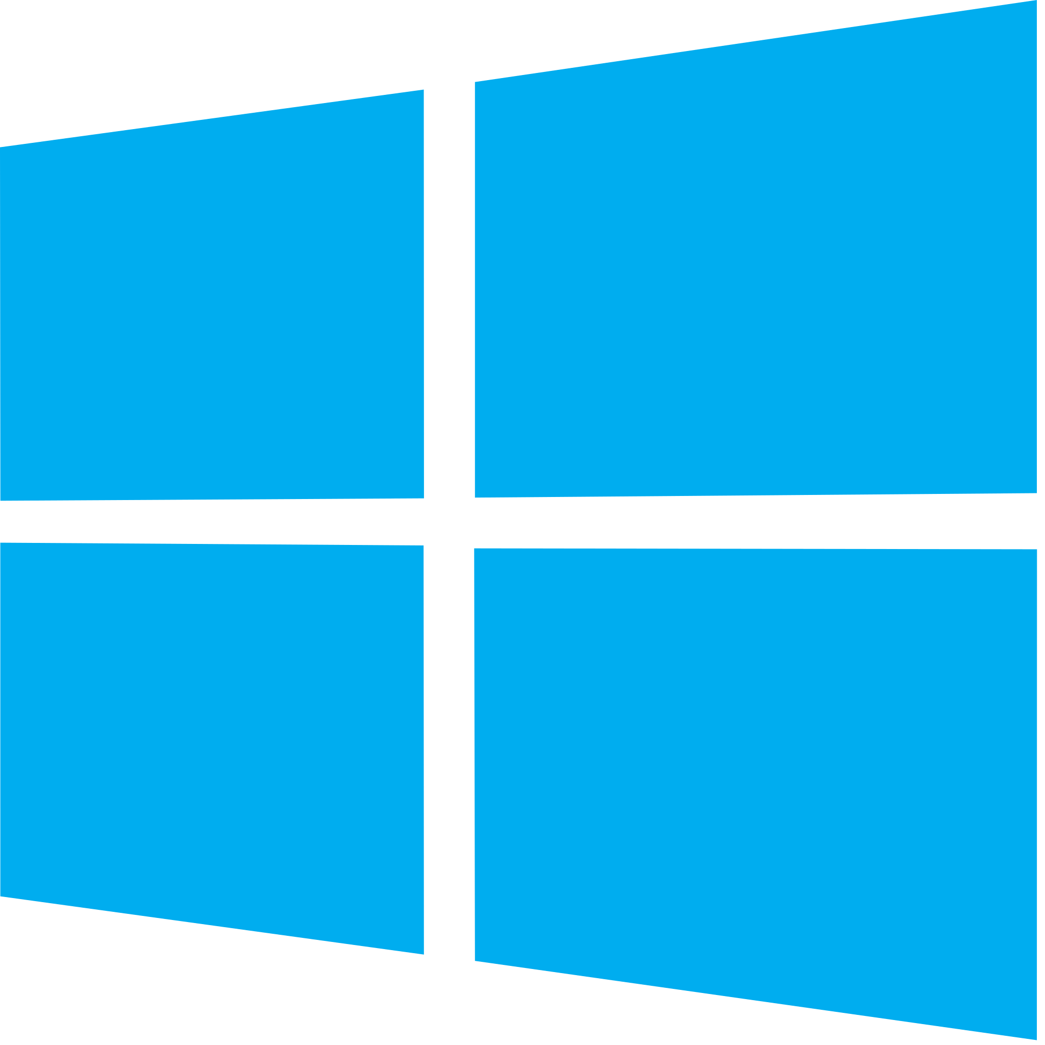
Azure Virtual Desktop
AKA Windows Virtual Desktop (WVD)
PaaS Service
Leverages Virtual Desktop Infrastructure (VDI)
Separates data and software from Hardware
Minimizes provisioning time
Use to provision machines for a team to access work files and apps
Client for each platform + Web Client

Slide 29
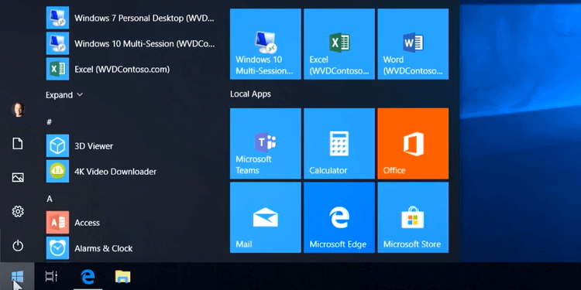
Azure Virtual Desktop

Slide 30




Prepare for The Exam (Q/A)
The format in which Azure Logic Apps workflows are persisted is ……………
XML
JSON
YAML
You need to deploy a solution that runs based on schedule and you pay only for the time that your code is running. Which Azure service to use?
Azure Container Instance
Azure Function with App Service Plan
Azure Function with Consumption Plan

Slide 31

Summary
Use ACI when you host single instance of a solution (e.g. Batch Job)
Use AKS when your solution adopts microservice architecture
Use Azure Function and Logic Apps when you have event driven logic and you want to pay only while your workload is running
Use Azure Virtual Desktop when you need to provision multiple desktop machines to access work files through client devices that run different OSs
Notes:
How Cloud Can Help DevOps Transformation

